Slide 1
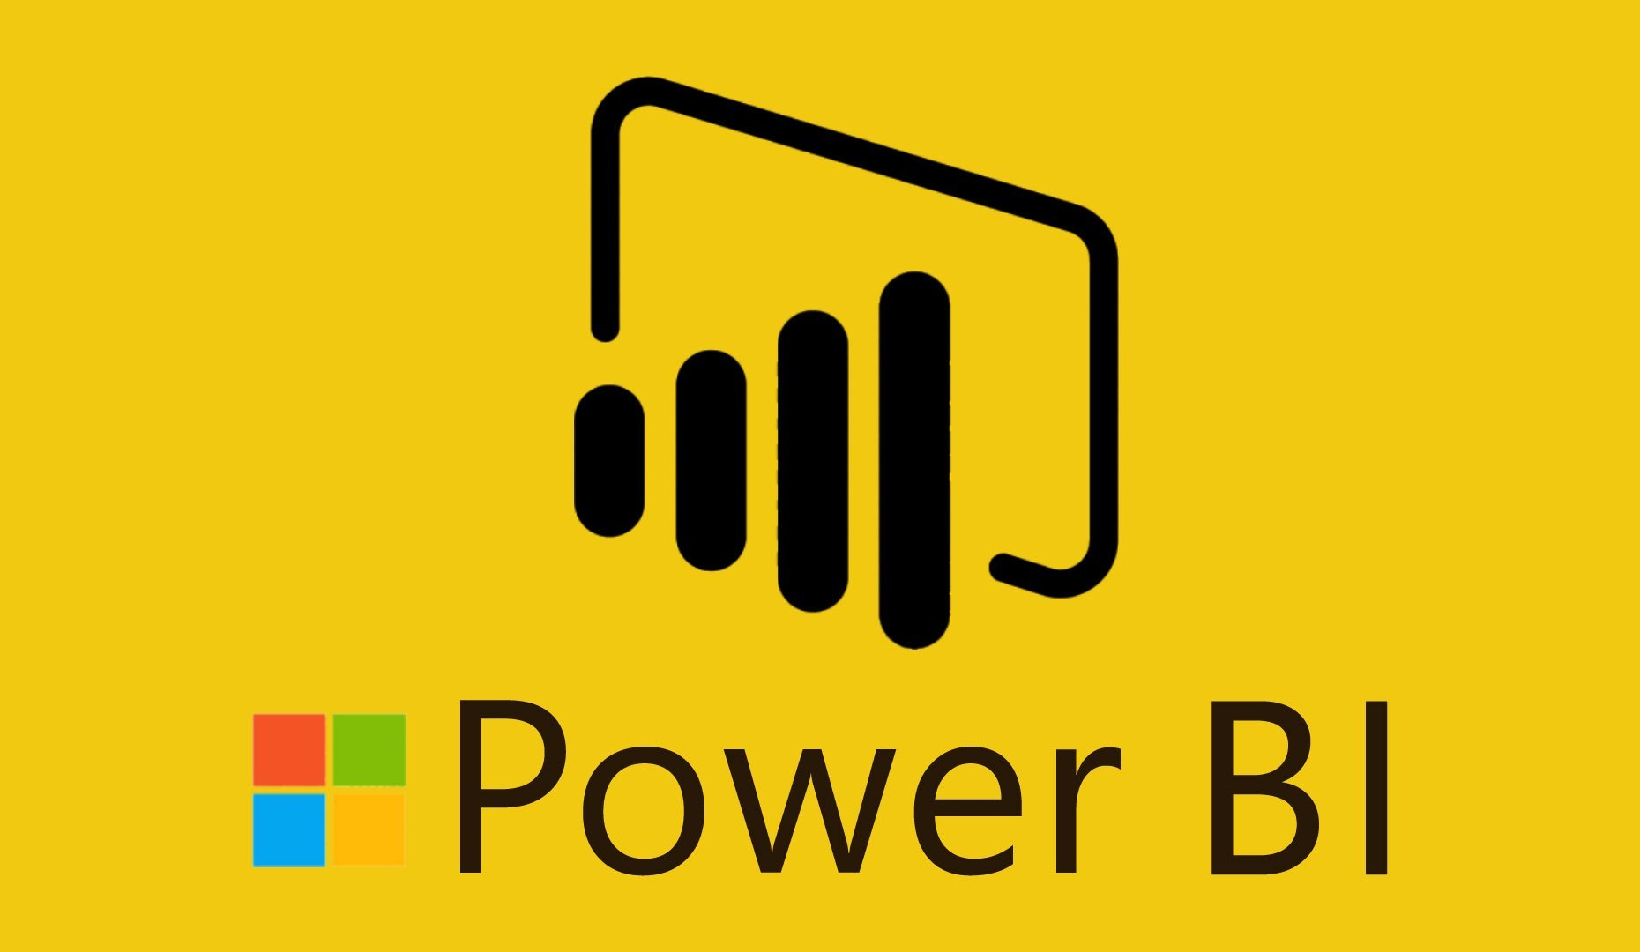

Slide 2
Power BI – Getting Data
Power BI Architecture
Introduction to data source
Different Views In Power BI
Get Data from Files
Get Data from Online Services- OneDrive/ SharePoint
Get Data from Folders
Get Data from web
Get Data from Relational data sources
Selecting Storage Mode

Slide 3
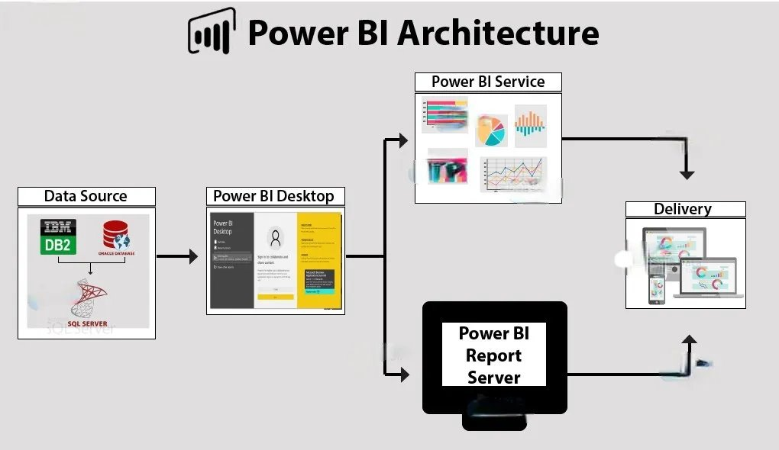

Slide 4
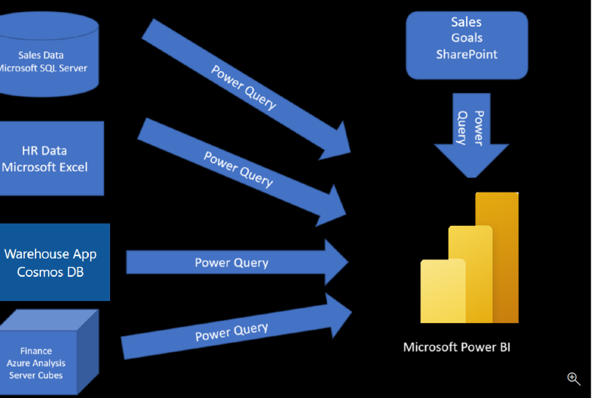
Introduction to Data Source

Slide 5
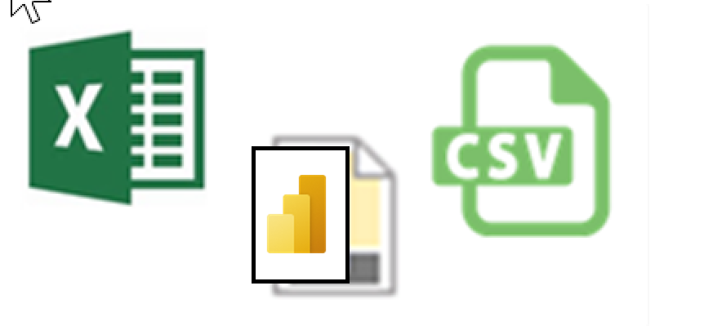
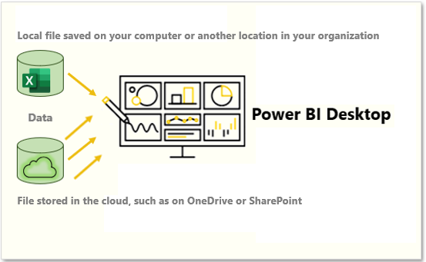
Get Data from Files
Flat File Locations
Local
One Drive
SharePoint

Slide 6
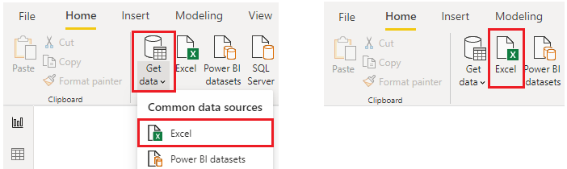
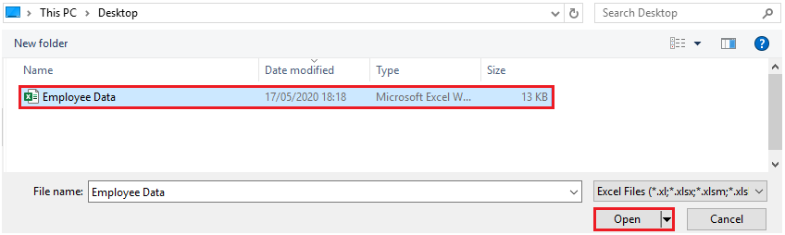
Get Data from Local Files
Connect to data in a file

Slide 7
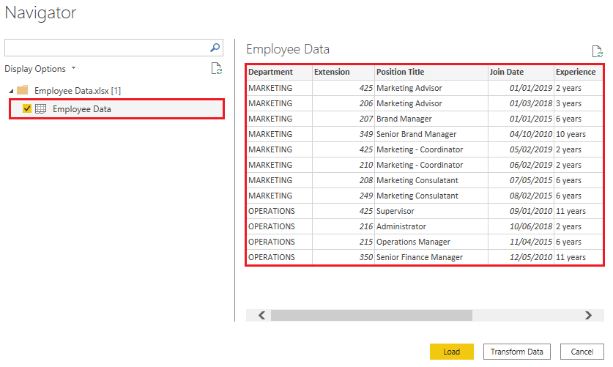
Get Data from Local Files
Select the file data to import

Slide 8
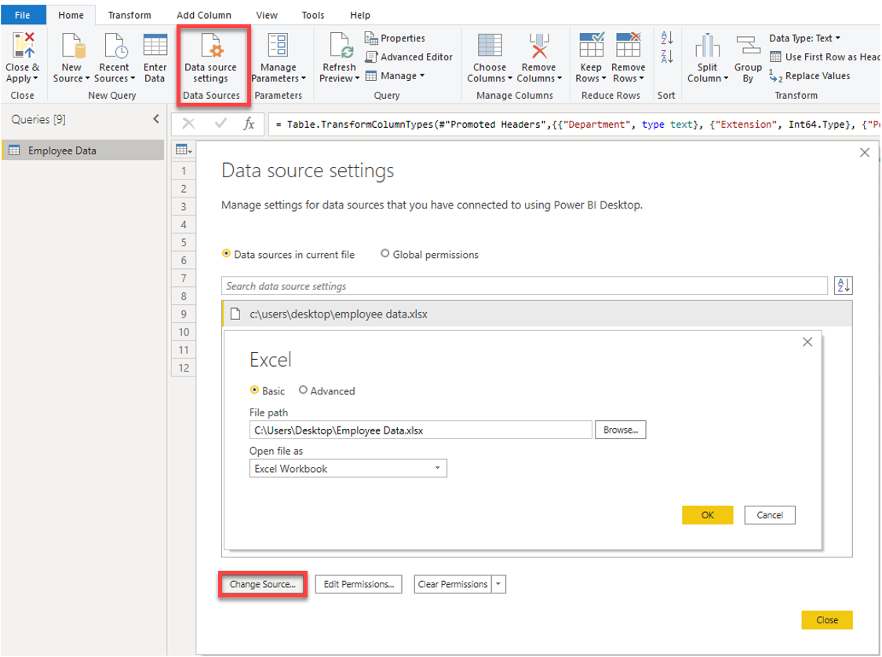
Get Data from Local Files
Change the source file

Slide 9
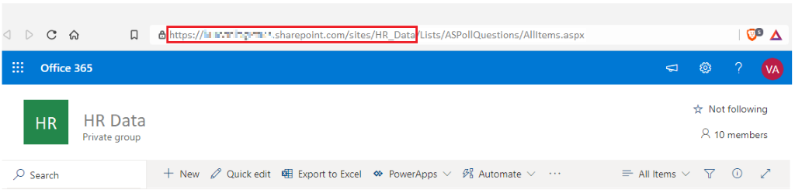
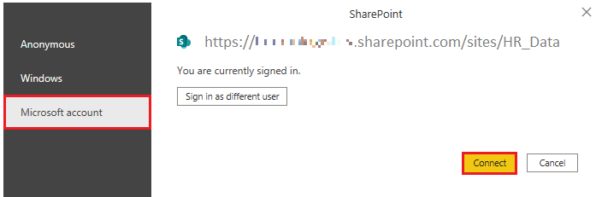
Get Data from OneDrive\SharePoint
Connect to Data in an application

Slide 10
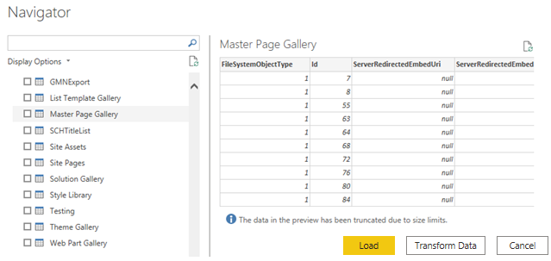
Get Data from OneDrive\SharePoint
Choose the application Data to import

Slide 11

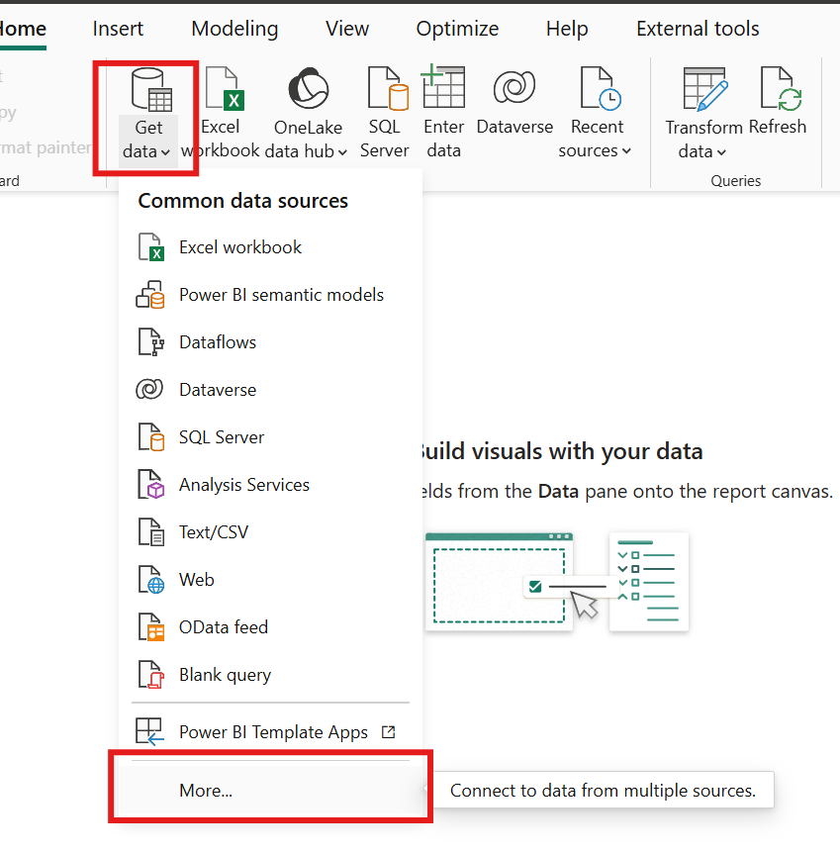
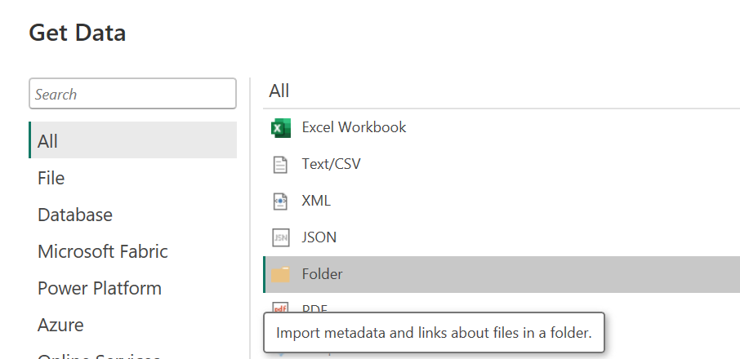
Get Data from Folders

Slide 12
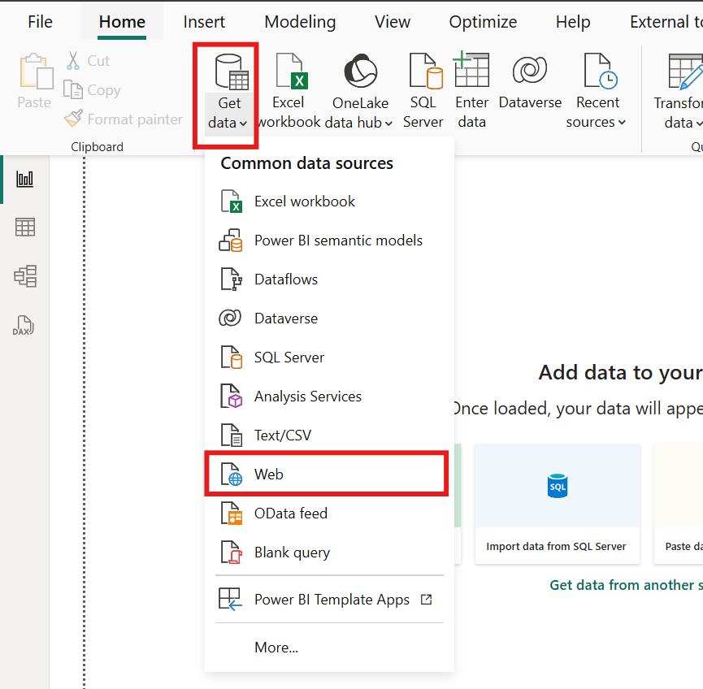
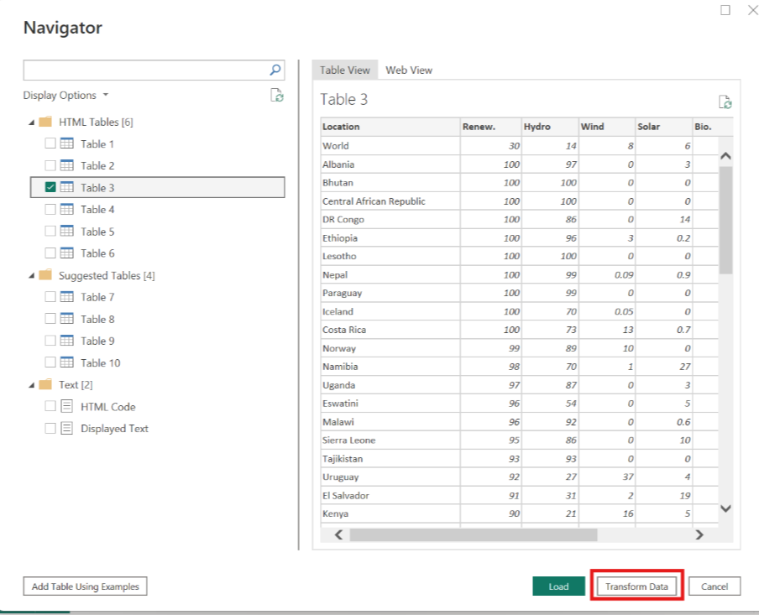
Get Data from Public Websites

Slide 13
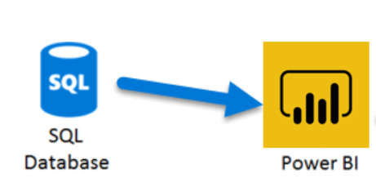
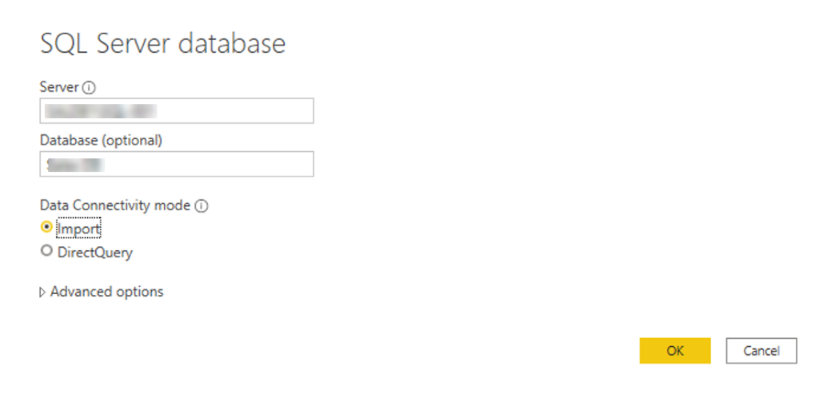
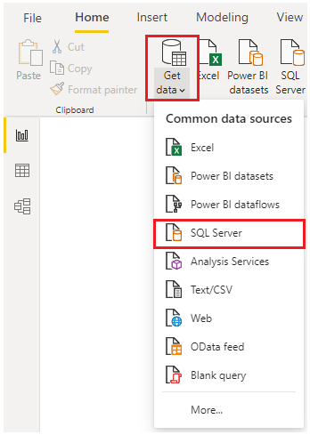
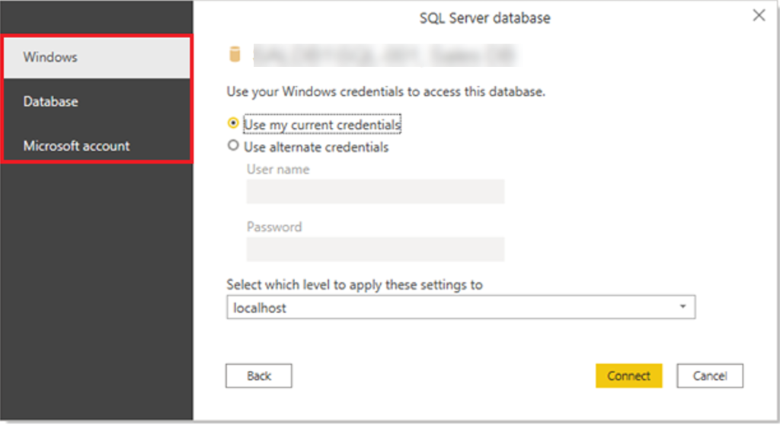
Get Data from Relational Data Sources
Change to data in relational database

Slide 14
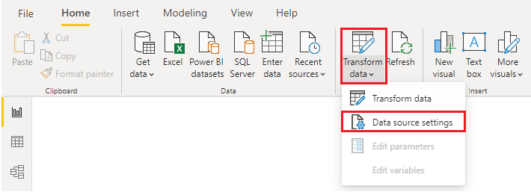
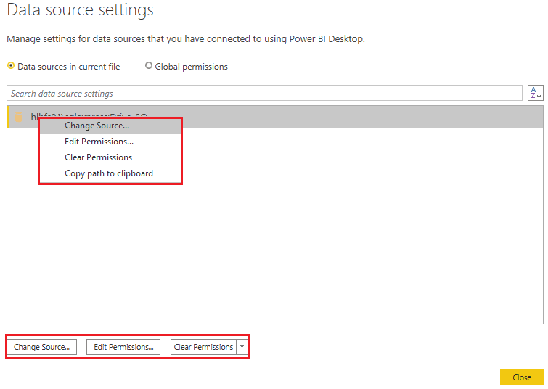
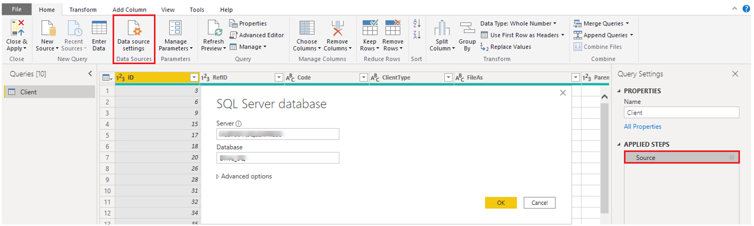
Get Data from Relational Data Sources
Change Data Source Settings

Slide 15
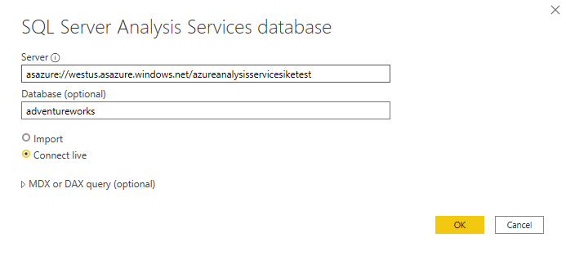
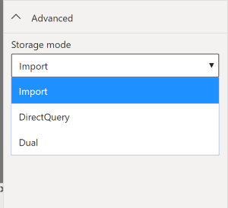
Select a Storage Mode
Three different types of Storage Modes
Import
Direct Query
Live Connection
Dual (Composite)

Slide 16
Storage Modes in Power BI
Import Mode
✅ Pros: Fastest performance, works offline, supports full data modeling and DAX.
⚠️ Cons: Requires scheduled refresh, can be outdated if not refreshed, larger memory usage.
DirectQuery Mode
✅ Pros: Near real-time data, no data duplication, lower storage footprint.
⚠️ Cons: Slower performance, limited DAX/modeling capabilities, depends on source system speed.
Live Connection
✅ Pros: Real-time connection to SSAS or Power BI datasets, centralized models.
⚠️ Cons: No data modeling in Power BI, no combining with other data sources.
Dual Mode (Composite Models)
✅ Pros: Flexibility of Import and DirectQuery combined, optimized performance and real-time mix.
⚠️ Cons: Can get complex to manage, requires understanding of storage behavior.

Slide 17
Quiz Time
What is Power BI primarily used for?
A) Web development
B) Data visualization and business intelligence
C) Graphic design
D) Video editing
Which tab in Power BI Desktop allows you to access the 'Get Data' feature?
A) Insert
B) Home
C) View
D) File
Which of the following is NOT a data source that Power BI can connect to?
A) Excel
B) SQL Server
C) Microsoft Word
D) SharePoint

Slide 18
Quiz Time
What is the difference between importing data and connecting live to a data source in Power BI?
A) Importing data allows real-time updates; connecting live does not.
B) Importing data is static; connecting live allows real-time updates.
C) Both methods allow real-time updates.
D) Neither method allows real-time updates.
Which of the following is NOT a step in the process of importing data using Power BI's 'Get Data' feature?
A) Selecting the data source
B) Transforming the data
C) Creating a visualization
D) Loading the data into Power BI

